Slide 1
Economic Impact of Sports
Chapters 14-15

Slide 2
Facilities, Franchises and Public Policy
Chapter 14

Slide 3
Lesson: Franchises
Objectives:
Describe external benefits of hosting a franchise
Outline the costs associated with franchises
Interpret the concept of cost-benefit analysis to explain why sports subsidies do not generate net gains

Slide 4
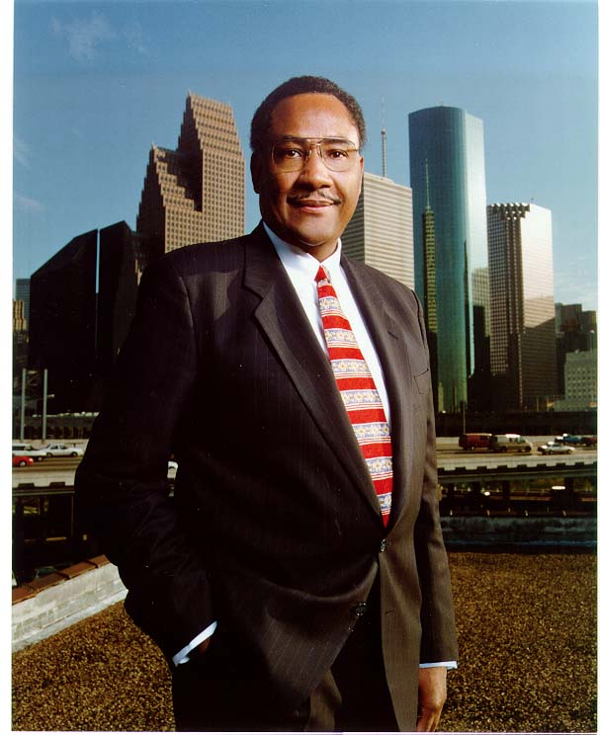
“Having a football team back in Houston will bring thousands of visitors to our city, and it will generate millions of dollars in our city. I’m excited about our new stadium with a retractable roof. And we’re also very happy about getting a Super Bowl, and as you know that’s very important economically to the city. It will generate probably $300 or $400 million into our economy. But more importantly, if focuses attention on a city that people do not know enough about.
--Houston Mayor Lee Brown
(1999)
Public Funding for Sports

Slide 5
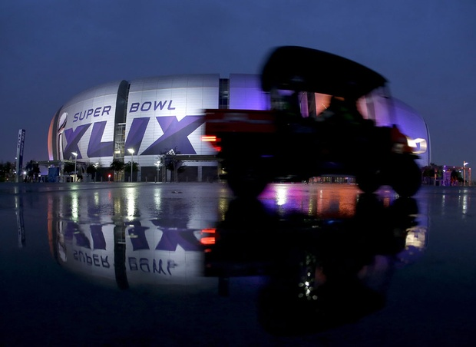
The Burden of Hosting the Super Bowl
More on Hosting
Padding Required: Research on Revenue from Super Bowl
Requirements to Host
Hosting Major Events

Slide 6
Economic Incentives to Host
Economic benefits from hosting a franchise - Myth or reality?
Let’s look at the possible benefits:
Job creation
Are the jobs additional jobs? Sometimes these are the jobs that would exist in other areas where fans would spend their money had they not gone to games
Greater tax revenues
Experience shows tax revenue does not increase
Enhanced prestige
Unclear if it attracts or puts off businesses
Consumption benefits
Having a team provides commonality (fan pride, local unity) that is not measurable in dollars. But not tangible one quantifiable – so it is hard for the city/club to collect these benefits

Slide 7
Economic Incentives to Host
But leagues are monopolists:
o Leagues are organized to give teams market power through “exclusive territories”
o Leagues offer better outcomes for member owners in negotiations with media providers, players, host cities
o Leagues can use relocation threats or perform team expansions as they please

Slide 8
Competition for Franchises / Events
Major sports leagues are monopolies. They restrict the number of teams on a league to max profits.
Not every city can host a team – so there is more demand than supply. Thus cities are willing to offer a lot in exchange for hosting a team.
Stadiums
Pro teams often rent the venue for home games.
Terms of lease vary: from no rent to very high rent. Some lease payments are tied to ticket sales or concession/parking revenues
Stadiums are often a financial disaster for local governments
Example: The White Sox pay $1 to use the U.S. Cellular Field (formerly Comiskey Park)
Sometimes building really expensive stadiums is worth it – depends on how much consumer surplus it generates

Slide 9
Equity/Political Arguments

Slide 10
The “Need” For New Facilities
Incumbent franchises often demand new facilities
If the facility is not built, the franchise threatens to leave their location
Examples:
Example 1. L.A. Rams
Originally Cleveland Rams, moved to LA in 1946 for the 103,000-seat Los Angeles Memorial Coliseum
Moved to Anaheim Stadium in 1980
Unable to secure a stadium in LA, they move to St. Louis, where they were promised the Edward Jones Dome
2016: New stadium is promised to the LA Rams. They move to LA Memorial Coliseum. Will move to the Inglewood Stadium in 2019
Example 2: Seahawks and Mariners

Slide 11
The “Need” For New Facilities
Example 2: Seahawks and Mariners
Mariners and Safeco Field
Vote in King County (1995) on raising sales tax by 0.5% toward the cost of the new stadium
Vote failed (50.1% to 49.9%)
Team threatened to move
The decision was made behind the scenes: Special funding package was passed in state legislature
Mariners’ Lease
Seahawks’ New Stadium/Exhibition Center
the background
Voting on a “Complex” Simple Referendum – explain how the “simple” yes/no vote was actually confusing
Here is the original voter’s pamphlet from that referendum: https://docs.google.com/viewer?a=v&pid=sites&srcid=ZGVmYXVsdGRvbWFpbnxyb2Rzd2VicGFnZXN8Z3g6MzE4M2Q0ZDk2ZmZhY2M1Zg
The vote passed 51.1% to 48.9%.
Team moved to a new stadium

Slide 12
Stadium Revenues
Even though the cities may subsidize the stadiums, the clubs typically capture the revenues:
Parking
Naming rights
Concessions
Luxury seating
Personal seat licenses
Why these revenues are attractive to the club:
There are few (if any) costs required to generate these revenues
These revenues are typically not shared with the rest of the league

Slide 13
The Winner’s Curse
The Winner’s Curse: The city may pay more than the franchise is worth, as a result of bidding (and being the highest bidder)
Why would the city want to be the highest bidder:
It may profit from the team more than the rival cities (if it is larger, has more residents, a suitable facility etc)
It may have overestimated the costs
The bidding becomes a contest in and of itself

Slide 14
A Numerical Example
Suppose there are two cities that want a professional team
City A: The demand for tickets is P = 100 – 0.001Q
marginal revenue is MR = 100 – 0.002Q and marginal cost MC =10
As a result, locating to City A will maximize the profits by operating where MR= MC:
100 – 0.002 = 10 → Q* = 45,000 → P* = $55
Max Profit = (55-10)*45,000 = $2,025,000
City B: The demand for tickets is higher: P = 120 – 0.001Q
marginal revenue is MR = 120 – 0.002Q and marginal cost MC =10
As a result, locating to City A will maximize the profits by operating where MR= MC:
120 – 0.002 = 10 → Q* = 55,000 → P* = $65
Max Profit = (65-10)*4=55,000 = $3,025,000
Result: the team will opt for City B since it offers more profit --- assuming no subsidy is offered!

Slide 15
Should a Sports Franchise be Subsidized?
Not all sports franchises are profitable: some lose money or go bankrupt
Sometimes the losses of a team are absorbed by the owner:
Team’s losses may offer big tax breaks
Example: Howard Schulz owned the Seattle Supersonics and claimed they operated at a loss. But he got tax breaks as a result of those losses
Two economic arguments in favor of the subsidy:
Subsidy lets the owners collect the true value that the team is to society. This lets them improve the team quality
Subsidizing a money-losing owner makes sense if it helps to prevent his relocation (condition: only in cases when subsidizing is better than losing the team altogether)

Slide 16
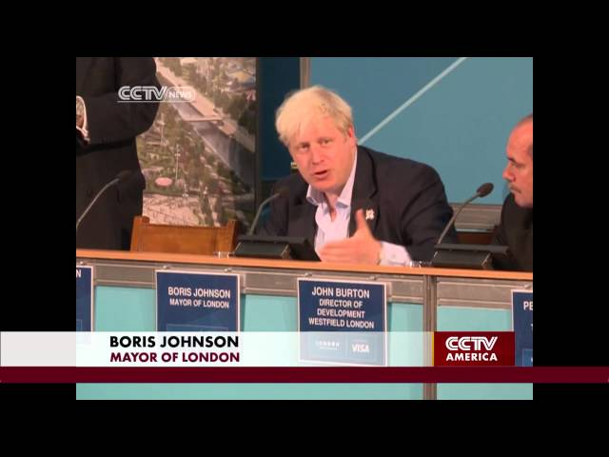
London’s Olympic Sized Budget
(link)
https://youtu.be/8HmWWZsSc0c
GDP growth before and after hosting the olympics
(link)
Economic Impact Studies

